Slide 1
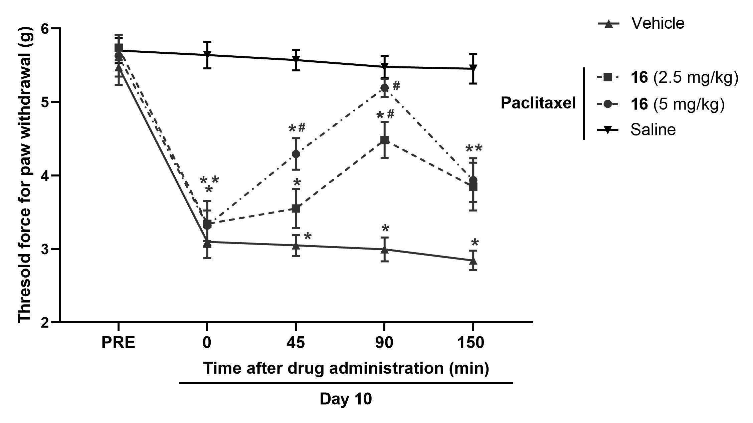
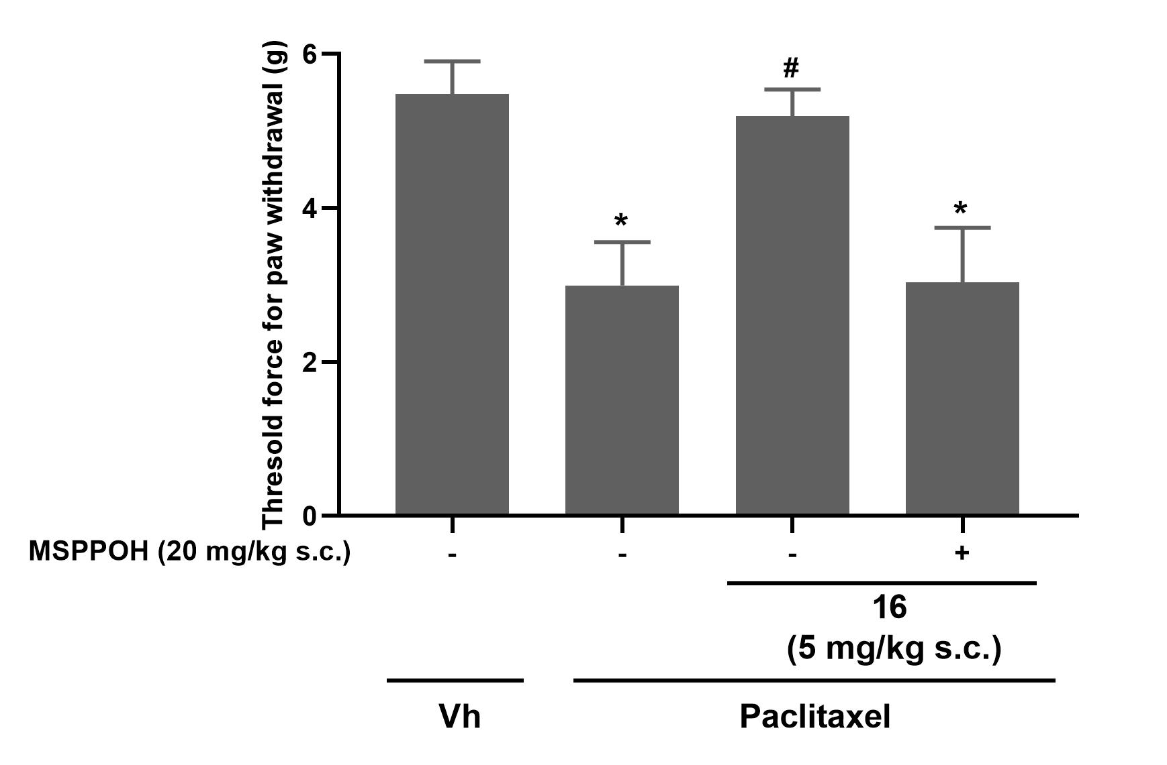
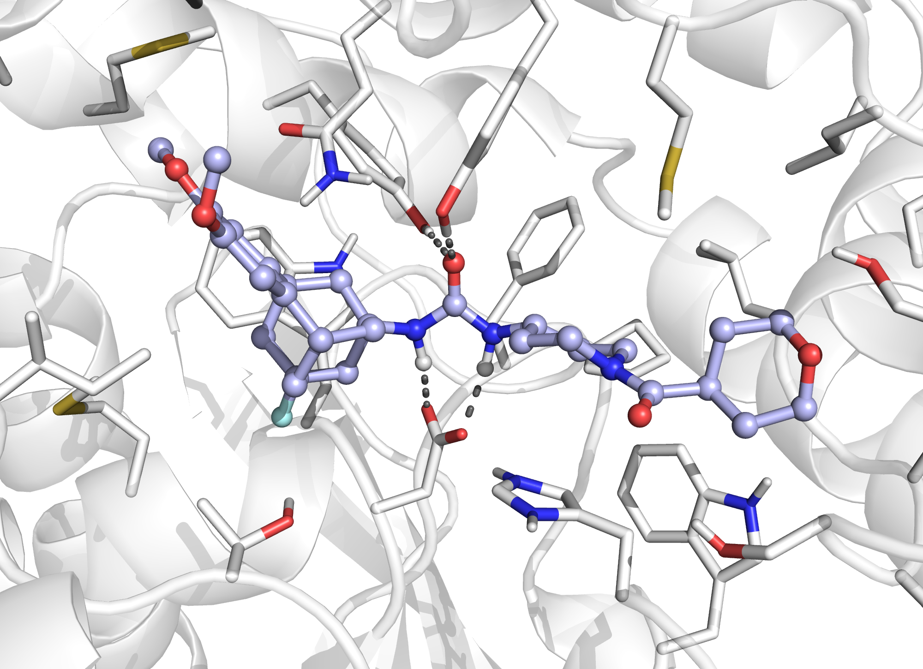
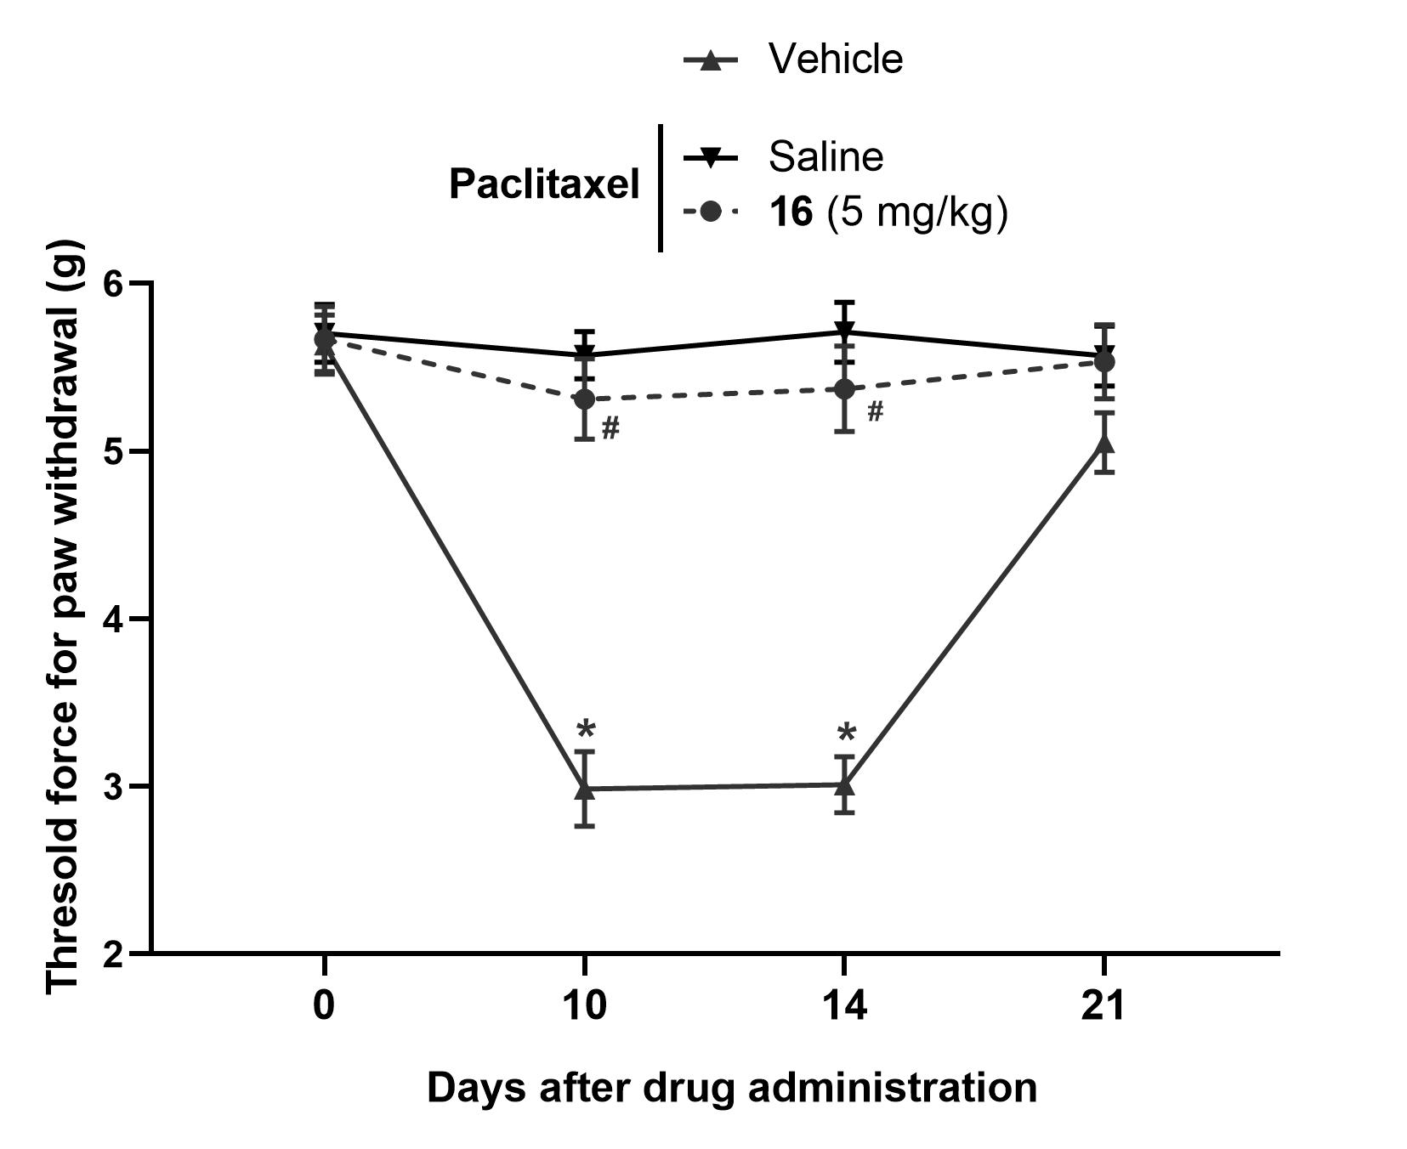
A new indication for soluble epoxide hydrolase inhibitors:
Design, synthesis and in vivo evaluation of novel ureas in a murine model of chemotherapy-induced neuropathic pain
Sandra Codony¹, Beatrice Jora¹, Miriam Santos-Caballero², Andreea L. Turcu¹, Carla Calvó-Tusell³, Christophe Morisseau⁴, M. Isabel Loza⁵, José M. Brea⁵, Clara Bartra⁶, Coral Sanfeliu⁶, Belén Pérez⁷, Christian Griñán-Ferré⁸, Mercè Pallàs⁸, Bruce D. Hammock⁴, Sílvia Osuna^{3,9}, Ferran Feixas³, Enrique J. Cobos^{2,} Santiago Vázquez¹
¹Laboratori de Química Farmacèutica (Unitat Associada al CSIC), Facultat de Farmàcia i Ciències de l'Alimentació i Institut de Biomedicina (IBUB), Universitat de Barcelona, Av. Joan XXIII, 27-31, 08028 Barcelona, Spain. ²Department of Pharmacology, Faculty of Medicine and Biomedical Research Center (Neurosciences Institute), University of Granada. Biosanitary Research Institute ibs.GRANADA, Avenida de la Investigación 11, 18016, Granada, Spain. ³CompBioLab Group, Departament de Química and Institut de Química Computacional i Catàlisi (IQCC), Universitat de Girona, C/ Maria Aurèlia Capmany 69, 17003 Girona, Spain. ⁴Department of Entomology and Nematology and Comprehensive Cancer Center, University of California, Davis, CA 95616, USA. ⁵Innopharma Screening Platform, Biofarma Research Group, Centro de Investigación en Medicina Molecular y Enfermedades Crónicas, Universidad de Santiago de Compostela, Edificio CIMUS, Av. Barcelona, S/N, E-15706 Santiago de Compostela, Spain. ⁶August Pi i Sunyer Biomedical Research Institute (IDIBAPS), Barcelona, Spain. ⁷Department of Pharmacology, Therapeutics and Toxicology, Autonomous University of Barcelona, E-08193 Bellaterra, Spain. ⁸Pharmacology Section, Department of Pharmacology, Toxicology and Therapeutic Chemistry, Faculty of Pharmacy and Food Sciences, Institute of Neurosciences (NeuroUB), Universitat de Barcelona, Av. Joan XXIII 27-31, 08028 Barcelona, Spain. ⁹Institució Catalana de Recerca i Estudis Avançats (ICREA), 08010 Barcelona, Spain.
sandra.codony@ub.edu
INTRODUCTION
IN VITRO PROFILING
We have recently designed a new family of urea-based soluble epoxide hydrolase inhibitors (sEHI) of general structure I, with subnanomolar inhibitory activity. Of note, the introduction of a chlorine or a fluorine atom in the R₁ position of the scaffold, led to compounds with improved microsomal stability. Furthermore, the incorporation of bulky groups in the R₂ position was beneficial for increasing the solubility. Finally, a candidate was selected for in vivo efficacy studies in a murine model of visceral pain.¹
Cpd. | sEH IC₅₀ (nM)ª h / m | Microsomal stability (%)^{b} h / m / r | Cytochrome inhibition^{c} CYP2C19 | Solubility (μM)^{d} | PAMPA –BBB^{e} | Cytotoxicity LD₅₀ (μM)^{f,g} PI / MTT
7 | 4.5 / 4.5 | 100 / 27 / 45 | 36 | 35 | CNS +/- | > 100 / > 100
8 | 2.4 / 0.8 | 16 / 1 / 0.1 | 23 | 45 | CNS + | > 100 / > 100
9 | 1.9 / 0.6 | 22 / 4 / 0.1 | 40 | 28 | CNS + | > 100 / > 100
10 | 2.1 / 1.7 | 33 / 32 / 41 | 48 | 89 | CNS +/- | > 100 / > 100
11 | 4.1 / 6.7 | 92 / 70 / 8 | 29 | 86 | CNS - | > 100 / > 100
12 | 4.7 / 2.2 | 100 / 70 / 42 | 25 | 90 | CNS - | > 100 / > 100
13 | 0.4 / 2.5 | 69 / 17 / 58 | 37 | 76 | CNS - | > 100 / > 100
14 | 0.4 / 1.9 | 80 / 9/ 84 | 37 | 68 | CNS - | > 100 / > 100
15 | 0.4 / 0.4 | 42 / 81 / 54 | IC₅₀ = 6.5 μM | 87 | CNS +/- | > 100 / > 100
16 | 0.6 / 2.9 | 100 / 86 / 89 | 19 | 92 | CNS - | > 100 / > 100
Figure 1. Previous work by our research group.¹
In this work we explored the introduction of different groups in the aromatic ring of I to observe their impact on the inhibitory activity and the DMPK properties. Several derivatives were synthesized and submitted to a screening cascade that allowed us to select 16 for in vivo assays in a murine model of chemotherapy-induced neuropathic pain (CINP). CINP is a highly prevalent, severe side effect of several anticancer agents and, currently, no therapies offer adequate relief for it.^{2,3}
SYNTHESIS
Table 1. Screening cascade of the compounds 7 – 16. ªIC₅₀ values are the average of three replicates. ^{b}Percentage of remaining compound after 60 min of incubation with pooled human and mouse microsomes in the presence of NADPH at 37 °C. ^{c}% inh of selected cytochromes at 10 μM concentration of compound. ^{d}Solubility measured in a 1% DMSO: 99% PBS buffer solution. ^{e}Determined using the PAMPA-BBB assay. ^{f}Cytotoxicity tested by propidium iodide (PI) staining after 24h incubation in SH-SY5Y cells. ^{g}Cytotoxicity tested by 3-[4,5-dimethylthiazole-2-yl]-2,5-diphenyltetrazolium bromide (MTT) assay after 24h incubation in SH-SY5Y cells. h = human, m = murine, r = rat.
IN VIVO STUDIES: Treatment and prevention
Compound 16 was further characterized through an in vivo pharmacokinetics study in mice and displayed good properties: T_{max} = 2 h; C_{max} = 1.6 μg/mL; t_{1/2} = 1.0 h; AUC₀^{t} = 5.5 μg*h/mL; AUC₀∞ = 5.6 μg*h/mL. Next, its activity in a murine model of CINP was assessed. 16 completely reversed the sensory hypersensitivity induced by paclitaxel (Figure A), and this effect was abolished by the administration of MSPPOH (Figure B), indicating the selectivity of their antiallodynic effects. Finally, administration of 16 before each paclitaxel injection completely prevented the development of neuropathic allodynia (Figure C).
A
B
Scheme 1. Synthesis of compounds 1 – 16.
IN SILICO STUDIES
Figure 2. Molecular dynamics simulations show that the inhibitor is retained in the active site through three strong hydrogen bond interactions between the urea moiety and the central channel residues Asp335, Tyr383, and Tyr466. In the LHS pocket, the orientation of the benzohomoadamantane moiety is directed by the NH···π interaction between the Gln384 and the aromatic ring of the polycyclic scaffold, which is maintained along the MD simulations. Additionally, hydrophobic interactions are established with the side chains of Met339 and Ile363, while the methoxy groups are stabilized by the side chains of Ile375 and Phe381 (not shown). This network of hydrophobic interactions and hydrogen bonds in the sEH pocket is key to recognize and bind the inhibitor in the active site.
Tyr466
Gln384
Tyr383
Met419
Phe467
Ser415
C
Figure 3. Effect of 16 in paclitaxel-induced neuropathic pain in mice. Animals were treated once daily for 5 days with paclitaxel (2 mg/kg) or its vehicle. A Threshold force for paw withdrawal (g) after the subcutaneous (s.c.) administration of 16 (2.5 and 5 mg/kg), 10 days after the first paclitaxel administration. B Effect of the administration of 16 (5 mg/kg, s.c.) associated with MSPPOH (20 mg/kg, s.c.) or its solvent. C Time-course of the threshold force for paw withdrawal at 0, 10, 14 and 21 days after paclitaxel administration. 16 was administered at 5 mg/kg (s.c.) 30 minutes before each paclitaxel administration. A and B One-way ANOVA. C two-way repeated measures ANOVA. Tukey post-hoc test was used in all cases. Statistically significant differences vs paclitaxel vehicle: *p<0.05; and 16 vs its vehicle: #p<0.05.
Ile363
Met339
Asp335
His494
16
Trp525
CONCLUSIONS
The introduction of different groups in the aromatic ring of the benzohomoadamantane scaffold led to new potent sEHIs, some of them with IC₅₀ values in the subnanomolar range.
The introduction of two electron donor groups as in the 2,3-dimethoxy derivatives enhanced microsomal stability and solubility.
The incorporation of a bulky group such as the tetrahydro-2H-pyran-4-carbonyl in the N atom of the piperidine ring improved the potency at the human and murine enzyme.
Interestingly, compound 16 displayed excellent drug-like properties and good pharmacokinetic characteristics in terms of exposure, distribution and elimination.
Subcutaneous administration of compound 16 completely reversed in a dose dependent manner the sensory hypersensitivity induced by paclitaxel.
This analgesic effect was abolished by the administration of MSPPOH, indicating the selectivity of their antiallodynic effects.
Administration of compound 16 before each paclitaxel injection completely prevented the development of the neuropathic allodynia.
References
1. Synthesis, in vitro profiling, and in vivo evaluation of benzohomoadamantane-based ureas for visceral pain: a new indication for soluble epoxide hydrolase inhibitors. J. Med. Chem. 2022, 65, 13660-13680.
2. Chemotherapy-induced peripheral neuropathy: part 1-current state of knowledge and perspectives for pharmacotherapy. Pharmacol. Rep. 2020, 72, 486-507.
3. Soluble epoxide hydrolase inhibition alleviates chemotherapy induced neuropathic pain. Front. Pain Res. 2023, 3, 1100524.
Webpage:
Webpage:
@MCP_UB
Acknowledgements
@MCP_UB
This work was funded by the the Grant PID2020-118127RB-I00 funded by MCIN/AEI/10.13039/501100011033 and by “ERDF A way of making Europe” to S.V., and the Xunta de Galicia (ED431G 2019/02 and ED431C 2018/21). Partial support was provided by NIH-NIEHS River Award R35 ES03443, NIH-NIEHS Superfund Program P42 ES004699, NINDS R01 DK107767, and NIDDK R01 DK103616 to B.D.H.
MCP - Medicinal Chemistry
and Pharmacology
MCP - Medicinal Chemistry
and Pharmacology

