Slide 1
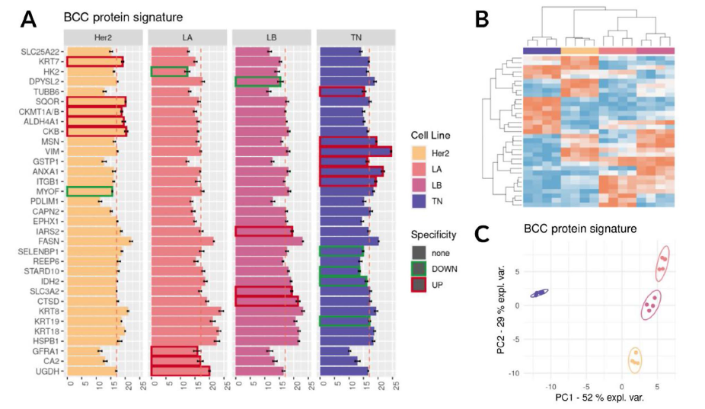
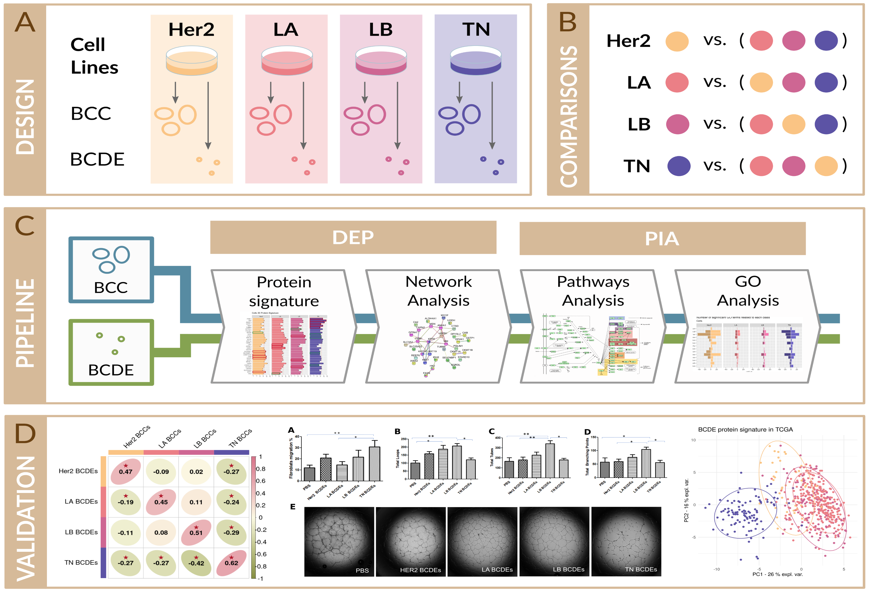
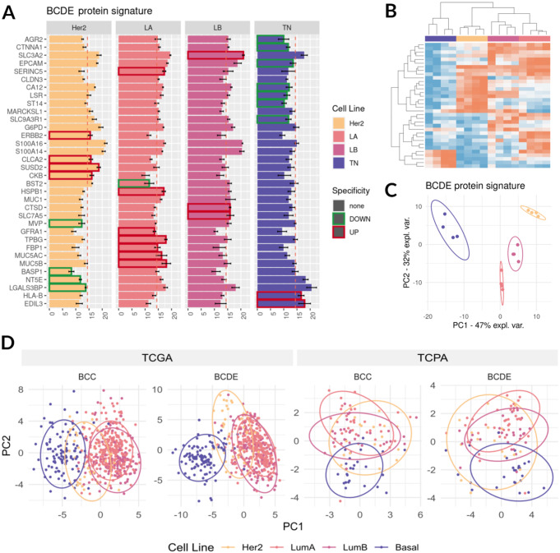
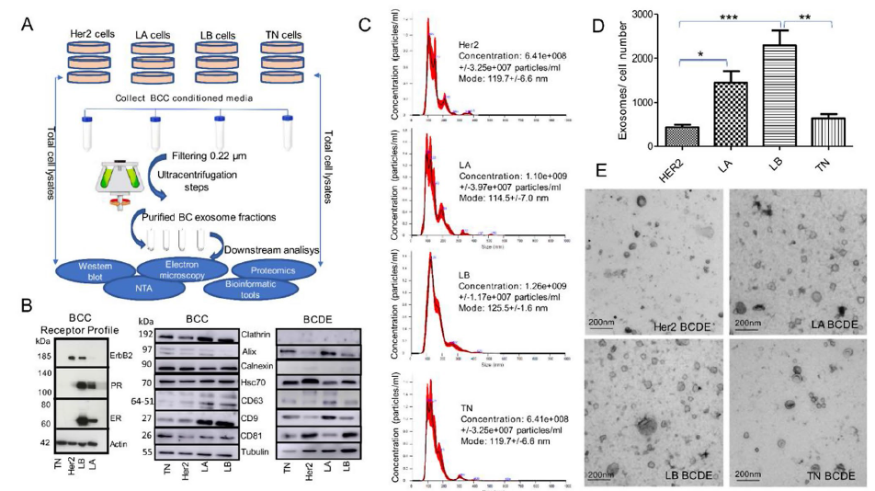
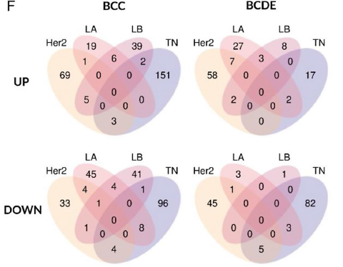
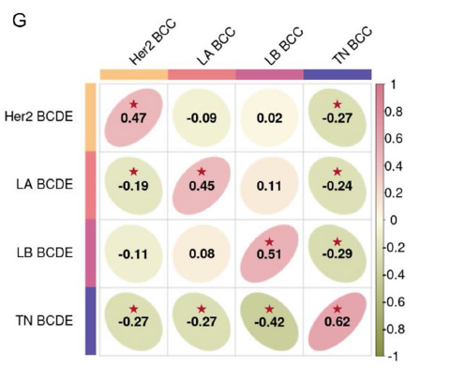
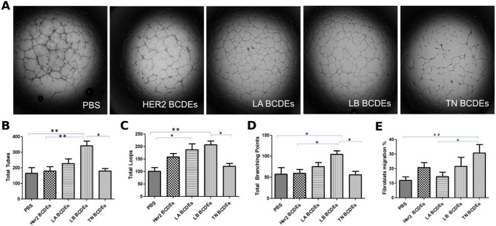
Comparative profiling of whole-cell and exosome samples reveals protein signatures that stratify breast cancer subtypes
Zoraida Andreu^{1,2,3,4}, Marta R. Hidalgo ^{2,3,5}, Esther Masiá ^{1,2,6}, Sergio Romera-Giner ³, Pablo Malmierca-Merlo ³, José A. López-Guerrero ^{2,4,7}, Francisco García-García ^{2,3}, María J. Vicent ^{1,2,6}
¹Polymer Therapeutics Laboratory and Screening Platform, Príncipe Felipe Research Center (CIPF), Av. Eduardo Primo Yúfera 3, Valencia, 46012 Spain. ²IVO-CIPF Joint Cancer Research Unit, Príncipe Felipe Research Center (CIPF), Av. Eduardo Primo Yúfera 3, Valencia, 46012 Spain. ³Computational Biomedicine Laboratory, Príncipe Felipe Research Center (CIPF), Av. Eduardo Primo Yúfera 3, Valencia, 46012 Spain. ⁴Laboratory of Molecular Biology, Foundation of the Valencian Institute of Oncology, Valencia, 46009 Spain. ⁵Department of Mathematics, School of Mathematics, University of Valencia, Valencia, 46010 Spain. ⁶CIBERONC, Carlos III Health Institute (IISCIII), Madrid, Spain. ⁷Department of Pathology, Medical School, Catholic University of Valencia ‘San Vicente Mártir’, Valencia, 46001 Spain
Introduction
Results
Breast cancer (BC) continues to be a significant health issue, and patient stratification is a challenge. Compared to traditional diagnostic methods, the analysis of liquid biopsies from easily accessible biological fluids (such as saliva, urine, and peripheral blood) provides a highly sensitive and minimally invasive diagnostic approach that quickly yields results. These bodily fluids contain extracellular vesicles, such as exosomes and endosomal-derived nanovesicles, which play crucial roles in disease-related pathways. They also represent a promising source of non-invasive biomarkers [1–3] , as they are present at elevated levels in the blood samples of cancer patients [4–6]. Additionally, proteomics has advanced our understanding of tumor heterogeneity and the underlying mechanisms by enabling the detection of protein markers.
In this study, we present the proteomic and functional characterization of breast cancer cells (BCCs) and breast cancer cell-derived exosomes (BCDEs) representative of four clinically-recognized subtypes - luminal A (LA; ER+, PR+, Her2-), luminal B (LB; ER+, PR+, Her2+), Her2-enriched (Her2; ER-, PR-, Her2+), and triple-negative (TN; ER-, PR-, Her2-) [7]. This analysis demonstrates intrinsic differences, correlations with clinical scenarios, and applicability of exosomes as non-invasive biomarkers to improve breast cancer patient stratification and disease monitoring.
2. A 33-protein Signature of BCCs Discriminates Subtypes and Provides Subtype-specific Functional Detail
Methods
(A) Barplots reporting the expression levels of the 33 BCC signature proteins (Her2, LA, LB, and TN). Boxes highlight upregulated (red) and downregulated (green) proteins for each BCC. (B) Heatmap of the expression levels of the 33 BCC signature proteins, with non-supervised clustering of the samples colored by the cell-of-origin. (C) The first and second components of a PCA of samples considering only the protein signature, colored by the cell-of-origin, with ellipse plots with a confidence level of 0.9. (D) PPI analysis of the BCC protein signature. Proteins colored by their association to GO functions Cytoskeleton organization (GO: 0007010), Cornification (GO:0070268), Oxidation-reduction process (GO:0055114), Cellular modified amino acid metabolic process (GO:0006575) and Invadopodium (GO:0071437)
3. A BCDE protein signature with subtype discriminatory potential
Workflow. (A) Analysis of the proteomic profiles of BCCs and BCDEs from four BC cell lines that represent common subtypes: Her2-positive (Her2, MDA-MB-453), Luminal A (LA, MCF7), Luminal B (LB, ZR-75), and triple-negative (TN, MDA-MB-231). (B) Independent comparisons for BCCs and BCDEs, assessing each cell line against the other three. (C) Differentially expressed proteins (DEPs) for both BCCs and BCDEs, defined protein signatures, and functionally analyzed the resulting networks. Through pathway inference analysis (PIA), we discovered Kyoto Encyclopedia of Genes and Genomes (KEGG) subpaths and biological Gene Ontology (GO) terms that showed differential activation. (D) Validation of proteomic signature using the Cancer Genome Atlas (TCGA) and the Cancer Proteome Atlas (TCPA) databases. Differentially activated pathways in BCDEs elicited corresponding responses in receptor cells and established that the BCDE proteomic signature reflects its cell of origin while identifying potential disease biomarkers in liquid biopsies.
(A) Barplots reporting the expression level of the 33 BCDE signature proteins (Her2, LA, LB, and TN). Boxes highlight upregulated (red) and downregulated (green) proteins for each BCDE. (B) Heatmap of expression levels of the 33 BCDE signature proteins, with non-supervised clustering of the samples colored by the cell-of-origin. (C) The first and second components of a PCA of samples considering only the protein signature, colored by the cell-of-origin, with ellipse plots with a confidence level of 0.9.
Results
4. Validation of the 33-protein signatures through The Cancer Genome Atlas (TCGA) and The Cancer Proteome Atlas (TCPA)
BCC and BCDE protein signatures discriminated TN from the LA and LB subtypes in the TCGA dataset but had more difficulty separating Her2 and could not discriminate between LA and LB. Interestingly, the BCDE protein signature represented the most powerful means of separating subtypes, especially for the TN subtype, providing evidence for the potential of exosomes as a source of subtype biomarkers in liquid biopsies.
1. Characterization of BCCs and BCDEs and differential protein expression analysis
5. Pathways analysis reveals functional differences in BCC and BCDEs subtypes
B
(A) Characterization workflow. (B) Western blot of BCC extracts confirming characteristic receptor expression and BCC/BCDE extracts for exosome marker expression (Clathrin/ Calnexin as quality control for contamination with other extracellular vesicle types). (C) The concentration and distribution of BCDEs were analyzed with the NanoSight NS300 (vertical axis, x107 particles/ml) and by size (horizontal axis, in nanometers [nm]). (D) Quantitative analysis of BCDEs. (E) Representative TEM images of BCDEs. Scale bar = 200 nm. (F) Intersection of significantly dysregulated proteins by subtype in BCCs and BCDEs. Venn diagrams demonstrate the number of commonly significantly upregulated (“UP”) and downregulated (“DOWN”) proteins in intersections for subtype comparisons. (G) Statistical correlations between subtype comparisons in BCCs (columns) and BCDEs (rows). Correlations among parental BCCs and BCDEs are positive, while non-parental relations present near-zero or negative values. Significant correlations are depicted with a red star. n = 3 in each experiment; error bars represent mean ± SEM, *p < 0.01, **p < 0.001, ***p < 0.0001; one-way ANOVA with post-Bonferroni’s Multiple Comparison Test
Number of subpathways altered in the top altered KEGG pathways in each BCC and BCDE.
6. Functional outcomes according to BCC and BCDEs subtype
Differential contribution of BCDEs to migration and angiogenesis according to subtype. (A) Bright-field images of tube formation assays by HUVECS incubated with BCDEs. (B-D) Quantitative analysis representative of (B) tubes, (C) loops, and (D) branching points formed by HUVECs. Bars represent mean ± SEM, **p < 0.01, ***p < 0.001; one-way ANOVA with the post, “Bonferroni’s Multiple Comparison Test of three different experiments, n = 3 wells in each experiment.
References
Mitchell MI, et al., 2022. Cancers 14(14):3350
Pinzani P, et al., 2021. Clin Chem Lab Med 59(7):1181–1200
Srivastava A, et al., 2018. AAPS J 20(5):82
Andreola G, et al., 2002. J Exp Med 195(10):1303–1316
Huber V, et al., 2005. Gastroenterology 128(7):1796–1804
Logozzi M, et al., 2009. PLoS ONE 4(4):e5219
Sarhangi N, et al., 2022. Mol Biol Rep 49(10):10023–10037
ACKNOWLEDGEMENTS
Association “Mou-te per elles.”
Biobank grant PT23/00083
SCSIE University of Valencia
Dr. Stuart P. Atkinson
Conclusions
Our study revealed protein signatures in BCCs and BCDEs that define subtypes, with significant positive correlations observed between BCCs and BCDEs.
The BCDE signature offers a promising starting point for further analysis of the role of exosomes as biomarkers of the TN subtype in liquid biopsies.
We provide evidence that BCDEs from different subtypes impact receptor cells differentially, triggering changes that replicate the functional profile of their cells of origin.

